Slide 1
Big Data. Fast Data.
June 2011
Ryan Betts, VoltDB Engineering
rbetts@voltdb.com / @ryanbetts

Slide 2
Volume. Velocity. Variation.
http://jtonedm.com/2011/05/24/ibms-big-data-platform-and-decision-management/
Analyzing streaming data to find patterns
Analyzing streaming data to make decisions.
James Taylor on Everything Decision Management

Slide 3
The Problem
Throughput: Lots of transactions: 10,000 to 1M TPS
Cost: Cheap transactions: $ / transaction must be tiny
Scale: Streaming writes. Reads of summary aggregates

Slide 4
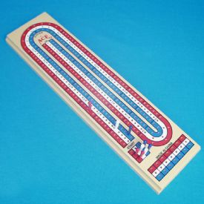
Giant score board in the sky
Financial tick streams
100k to 2M write/update TPS
1000’s of summary read TPS
Sensor inputs
50k – 500k writes/update TPS
100’s summary read TPS

Slide 5
Transaction Mix
Data Source
High-frequency transactions
Lower-frequency transactions
Real-time markets | Write/index all trades, store tick data | Show consolidated risk across traders
Networks, Exchanges, etc. | Real-time bidding, content optimization, | Real-time performance, network/exchange statistics, alerting
Call initiation request | Real-time authorization | Fraud detection/analysis
Inbound HTTP requests | Hit logging, analysis, alerting | Ad hoc inquiry and reporting
Online game | Rank scores: Defined intervals Player “bests” | Leaderboard lookups
Sensor scan | Package location updates | Package status, lost shipment, package rerouting
Financial trade monitoring
Digital Advertising
Telco call data record management
Website vulnerability detection
Online gaming micro transactions
Package tracking (logistics)
Notes:
----- Meeting Notes (6/2/11 13:18) -----
* enaged across markets
* consistent message across these conversations

Slide 6
Big Data Challenges
You need to validate in real-time
You need to count and aggregate
You need to enrich in real-time
You need to scale on demand
You need to learn and adapt
Big Data and You
Notes:
----- Meeting Notes (6/2/11 13:18) -----
scale: not just now, but at peak and in future
adapt: move processing to data.

Slide 7
VoltDB and big data
Throughput: Design choices favor throughput.
Cost: Commodity hardware. Efficient. Open source.
Scale: Clustered. Shared nothing. Clever.
Originated from MIT / Brown / Yale H-Store research project.
http://cs-www.cs.yale.edu/homes/dna/papers/vldb07hstore.pdf

Slide 8
Decision:
Scale horizontally
Replicate for fault tolerance

Slide 9
Decision:
Transaction == Stored Procedure
SQL for data access
Java for user procedure logic

Slide 10
Decision:
Eliminate stalls during transactions
No disk waits during a transaction
No server <-> client network chatter

Slide 11
Decision:
Concurrency by scheduling
not by locking

Slide 12
Decision:
ACID / Transactional
CAP-wise consistent
Notes:
----- Meeting Notes (6/2/11 13:30) -----
Accurate now - use Volt.

Slide 13
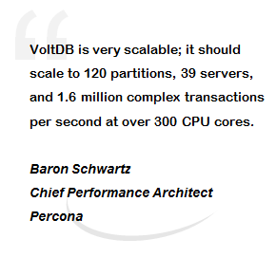
Decisions lead to: ACID & Throughput
Per node:
1 million SQL statements per second
50,000 multi-statement procedures per second
Per node TPC-C TPS on 3 and 6 nodes:
Notes:
----- Meeting Notes (6/2/11 13:30) -----
Barron Schwartz quote

Slide 14
How VoltDB Works

Slide 15
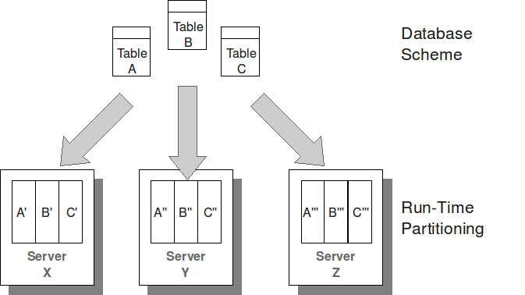
How: Data
Tables are horizontally split into PARTITIONS

Slide 16
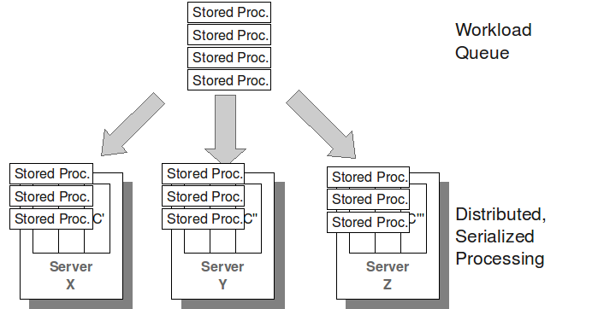
How: Processing
Procedures routed to, ordered and run at partitions

Slide 17
VoltDB procedures
Transaction == stored procedure invocation.
Two procedure types – both ACID
Single-Partition
All SQL operates within a single partition
Multi-Partition
SQL operations on partitioned tables across partitions
Insert/update/delete on replicated data

Slide 18
Running transactions
Single-threaded executor at each partition
No locking/dead-locks
Transactions run to completion, serially, at each partition
Single partition procedures run in microseconds
However, single-threaded comes at a price
Other transactions wait for running transaction to complete
Don’t do anything crazy in a procedure (request web page, send email)

Slide 19
A stored procedure
@ProcInfo(singlePartition=true,
partitionInfo=“tags.tag: 0”)
public class Insert extends VoltProcedure {
public final SQLStmt sql = new SQLSmt(
“INSERT INTO hashtags (tag, tweet_ts) VALUES (?,?);”);
public VoltTable[] run(String tag, long timestamp) throws… {
voltQueueSQL(sql, tag, timestamp);
return voltExecuteSQL(true);
}
}

Slide 20
Physical schema
Tables
Partitioned
Rows spread across cluster by table column
High frequency of modification (transactional data)
Replicated
All rows exists in all VoltDB partitions
Low frequency of modification (customers, city, state, …)
Materialized Views
Grouped, aggregated partitioned table data
Automatically updated as table data is changed
Export-only tables
Insert-only tables
Produces an externally consumable data stream
Indexes – composite keys, unique, non-unique
X
X
X
X
X
Notes:
----- Meeting Notes (6/2/11 13:42) -----
external store such as hadoop

Slide 21
Example View
-- Agg. votes by contestant. Determine winner
create view votes_by_contestant (
contestent_number, num_votes)
as select contestant_number, count(*)
from votes
group by contestant_number;

Slide 22
VoltDB Applications
Develop: Schema and procedures
Assemble: using VoltCompiler to prepare procedures
Deploy: application JAR file
Monitor: log4j, built-in stats procedures, memory monitor, VoltDB Enterprise Manager (commercial)
Notes:
Mention workshop for people that want more information about building a voltdb app.

Slide 23
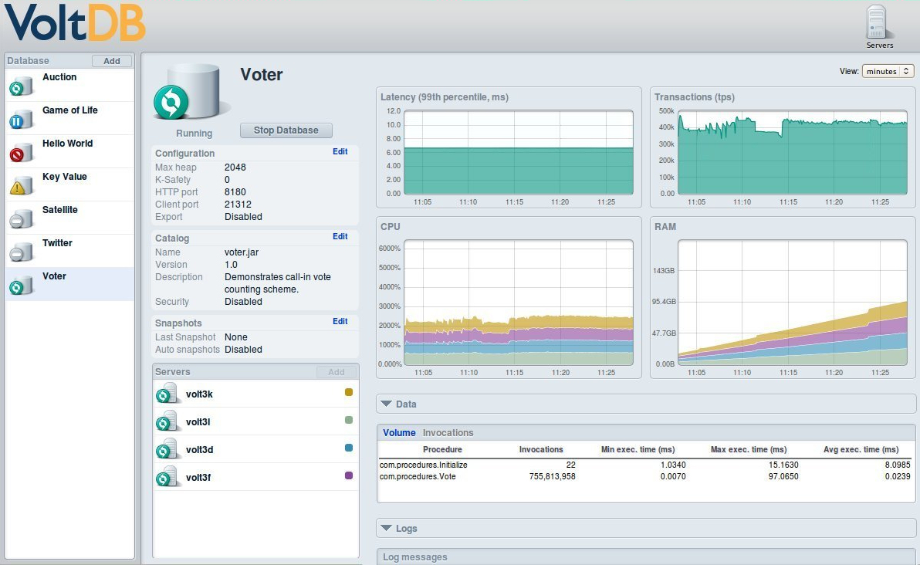
VoltDB Enterprise Manager

Slide 24
Built in memory monitor

Slide 25
Client Applications
Client application decisions
Language: Java, C#, C++, PHP, Python, Ruby, Erlang
Protocol: Wire or HTTP/JSON
If wire then Asynchronous or Synchronous
General client application structure
Connect to one or more nodes
Transactions are forwarded to appropriate node in the cluster
Perform work (call stored procedures)
Synchronously
Asynchronously
Drain (if any asynchronous calls were performed)
Disconnect

Slide 26
Conclusions
Sometimes it’s Velocity – not Petabytes
Value in real-time analysis of write intensive input
Workshop: Wednesday. Flyer with details.
Thank you!
rbetts@voltdb.com http://www.voltdb.com/
Twitter / @ryanbetts Freenode / #voltdb

Slide 27
A more concrete example
Single-partition vs. Multi-partition
select count(*) from orders where customer_id = 5
single-partition
select count(*) from orders where product_id = 3
multi-partition
insert into orders (customer_id, order_id, product_id) values (3,303,2)
single-partition
update products set product_name = ‘spork’ where product_id = 3
multi-partition
Partition 1
Partition 2
Partition 3
1 101 2
1 101 3
4 401 2
2 201 1
5 501 3
5 502 2
3 201 1
6 601 1
6 601 2
table orders : customer_id (partition key)
(partitioned) order_id
product_id
1 knife
2 spoon
3 fork
1 knife
2 spoon
3 fork
1 knife
2 spoon
3 fork
table products : product_id
(replicated) product_name

