Slide 1
Making Apache Hadoop Secure
Devaraj Das ddas@apache.org Yahoo’s Hadoop Team

Slide 2
Introductions
Who I am
Principal Engineer at Yahoo! Sunnyvale
Working on Apache Hadoop and related projects
MapReduce, Hadoop Security, HCatalog
Apache Hadoop Committer/PMC member
Apache HCatalog Committer

Slide 3
Problem
Different yahoos need different data.
PII versus financial
Need assurance that only the right people can see data.
Need to log who looked at the data.
Yahoo! has more yahoos than clusters.
Requires isolation or trust.
Security improves ability to share clusters between groups

Slide 4
History
Originally, Hadoop had no security.
Only used by small teams who trusted each other
On data all of them had access to
Users and groups were added in 0.16
Prevented accidents, but easy to bypass
hadoop fs –Dhadoop.job.ugi=joe –rmr /user/joe
We needed more…

Slide 5
Why is Security Hard?
Hadoop is Distributed
runs on a cluster of computers.
Trust must be mutual between Hadoop Servers and the clients

Slide 6
Need Delegation
Not just client-server, the servers access other services on behalf of others.
MapReduce need to have user’s permissions
Even if the user logs out
MapReduce jobs need to:
Get and keep the necessary credentials
Renew them while the job is running
Destroy them when the job finishes

Slide 7
Solution
Prevent unauthorized HDFS access
All HDFS clients must be authenticated.
Including tasks running as part of MapReduce jobs
And jobs submitted through Oozie.
Users must also authenticate servers
Otherwise fraudulent servers could steal credentials
Integrate Hadoop with Kerberos
Proven open source distributed authentication system.

Slide 8
Requirements
Security must be optional.
Not all clusters are shared between users.
Hadoop must not prompt for passwords
Makes it easy to make trojan horse versions.
Must have single sign on.
Must handle the launch of a MapReduce job on 4,000 Nodes
Performance / Reliability must not be compromised

Slide 9
Security Definitions
Authentication – Who is the user?
Hadoop 0.20 completely trusted the user
Sent user and groups over wire
We need it on both RPC and Web UI.
Authorization – What can that user do?
HDFS had owners and permissions since 0.16.
Auditing – Who did that?

Slide 10
Authentication
RPC authentication using Java SASL (Simple Authentication and Security Layer)
Changes low-level transport
GSSAPI (supports Kerberos v5)
Digest-MD5 (needed for authentication using various Hadoop Tokens)
Simple
WebUI authentication done via plugin
Yahoo! uses internal plugin, SPNEGO, etc.

Slide 11
Authorization
HDFS
Command line and semantics unchanged
MapReduce added Access Control Lists
Lists of users and groups that have access.
mapreduce.job.acl-view-job – view job
mapreduce.job.acl-modify-job – kill or modify job
Code for determining group membership is pluggable.
Checked on the masters.
All servlets enforce permissions.

Slide 12
Auditing
HDFS can track access to files
MapReduce can track who ran each job
Provides fine grain logs of who did what
With strong authentication, logs provide audit trails

Slide 13
Kerberos and Single Sign-on
Kerberos allows user to sign in once
Obtains Ticket Granting Ticket (TGT)
kinit – get a new Kerberos ticket
klist – list your Kerberos tickets
kdestroy – destroy your Kerberos ticket
TGT’s last for 10 hours, renewable for 7 days by default
Once you have a TGT, Hadoop commands just work
hadoop fs –ls /
hadoop jar wordcount.jar in-dir out-dir

Slide 14
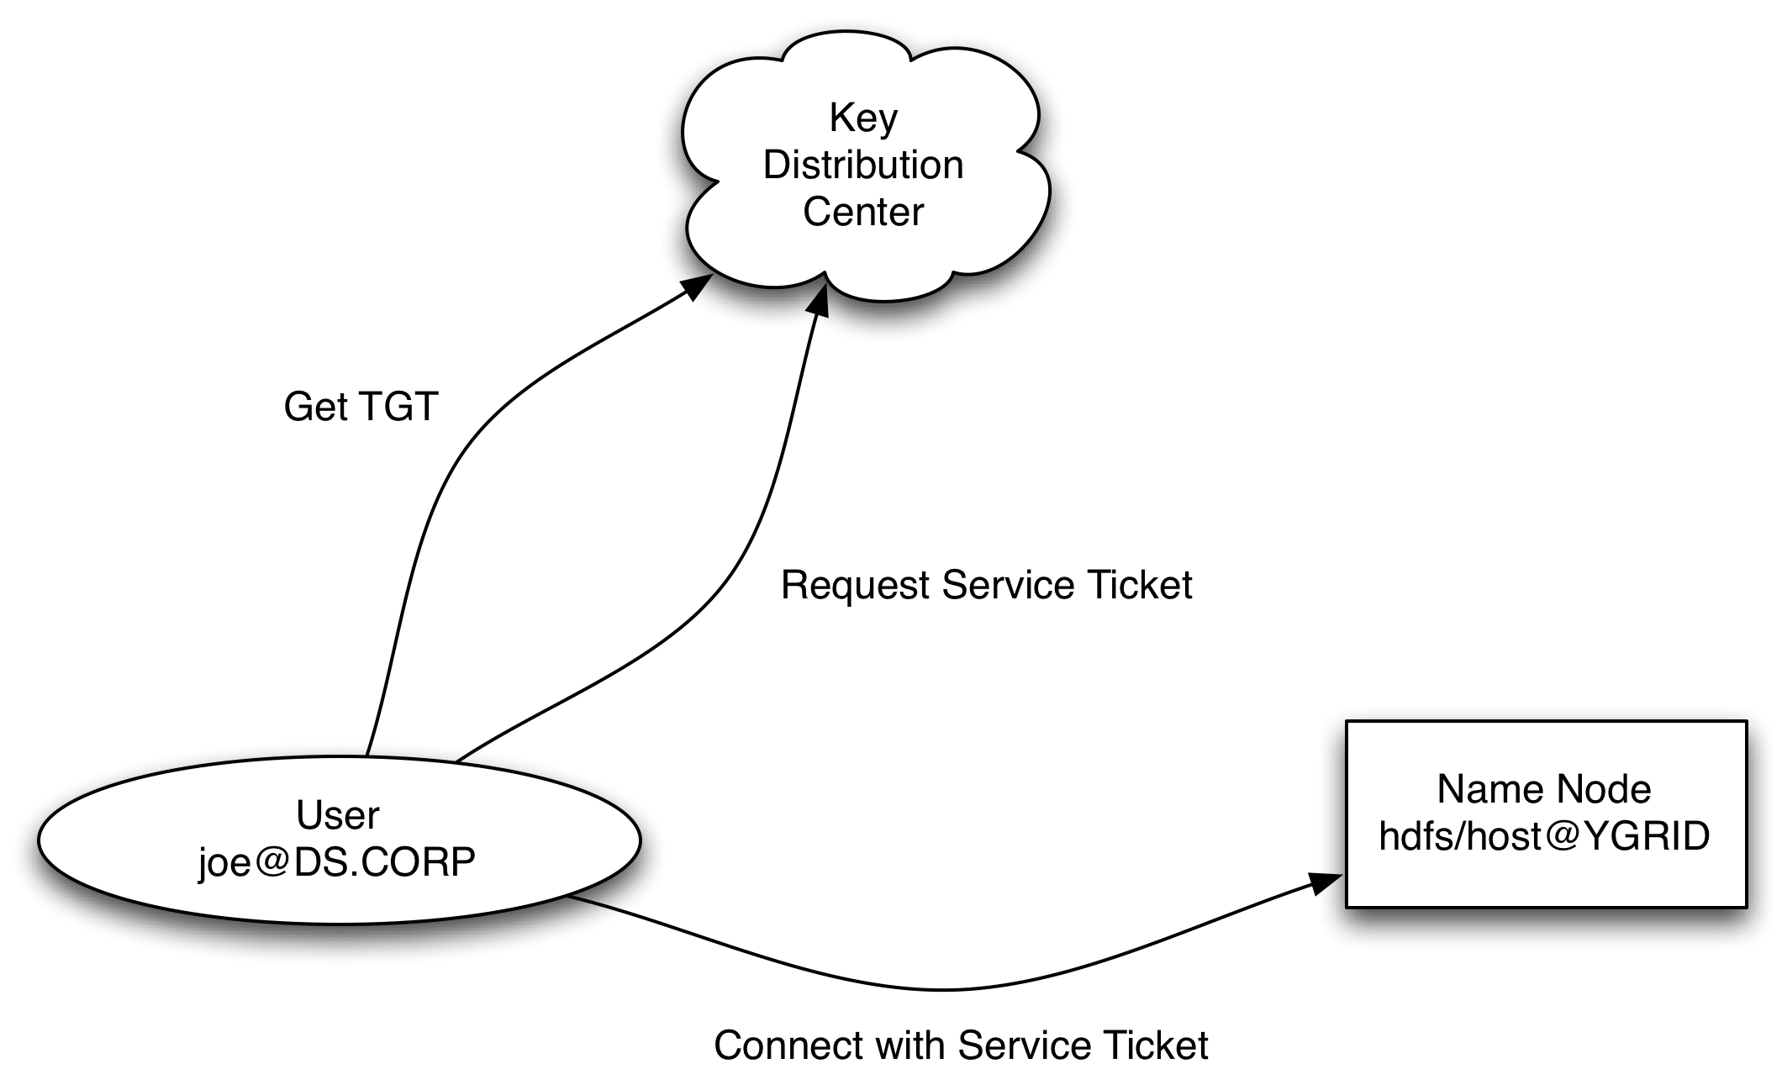
Kerberos Dataflow

Slide 15
HDFS Delegation Tokens
To prevent authentication flood at the start of a job, NameNode creates delegation tokens.
Krb credentials are not passed to the JT
Allows user to authenticate once and pass credentials to all tasks of a job.
JobTracker automatically renews tokens while job is running.
Max lifetime of delegation tokens is 7 days.
Cancels tokens when job finishes.

Slide 16
Other tokens….
Block Access Token
Short-lived tokens for securely accessing the DataNodes from HDFS Clients doing I/O
Generated by NameNode
Job Token
For Task to TaskTracker Shuffle (HTTP) of intermediate data
For Task to TaskTracker RPC
Generated by JobTracker
MapReduce Delegation Token
For accessing the JobTracker from tasks
Generated by JobTracker

Slide 17
Proxy-Users
Oozie (and other trusted services) run operations on Hadoop clusters on behalf of other users
Configure HDFS and MapReduce with the oozie user as a proxy:
Group of users that the proxy can impersonate
Which hosts they can impersonate from

Slide 18
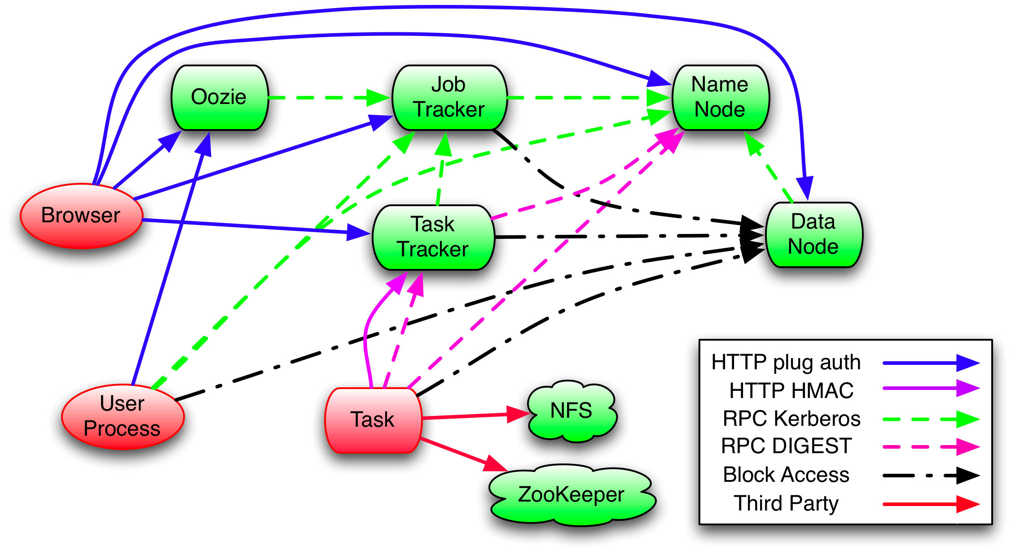
Primary Communication Paths

Slide 19
Task Isolation
Tasks now run as the user.
Via a small setuid program
Can’t signal other user’s tasks or TaskTracker
Can’t read other tasks jobconf, files, outputs, or logs
Distributed cache
Public files shared between jobs and users
Private files shared between jobs

Slide 20
Questions?
Questions should be sent to:
common/hdfs/mapreduce-user@hadoop.apache.org
Security holes should be sent to:
security@hadoop.apache.org
Available from
0.20.203 release of Apache Hadoop
http://svn.apache.org/repos/asf/hadoop/common/branches/branch-0.20-security/
Thanks!
(also thanks to Owen O’Malley for the slides)

Slide 21
If time permits…

Slide 22
Upgrading to Security
Need a KDC with all of the user accounts.
Need service principals for all of the servers.
Need user accounts on all of the slaves
If you use the default group mapping, you need user accounts on the masters too.
Need to install policy files for stronger encryption for Java
http://bit.ly/dhM6qW

Slide 23
Mapping to Usernames
Kerberos principals need to be mapped to usernames on servers. Examples:
ddas@APACHE.ORG -> ddas
jt/jobtracker.apache.org@APACHE.ORG -> mapred
Operator can define translation.

