Slide 1
The Multiple Uses of HBase
Jean-Daniel Cryans, DB Engineer @ SU
@jdcryans, jdcryans@apache.org
Berlin Buzzwords, Germany, June 7th, 2011

Slide 2
Overview
Why HBase
How to X in HBase
LOLcat to keep you awake, thanks to http://icanhascheezburger.com/

Slide 3
Why HBase
Big Data™
HBase scales as you add machines
Affinity with Hadoop
Same configuration files, scripts, language
About to write something similar anyway
Files in HDFS are immutable, then it turtles all the way down
Simple concepts
Master-slave, row-level ACID

Slide 4
How to Use HBase
General concerns:
Query patterns (direct key access, joins, etc)
duplicate data, join at the application level, embed in families
Read/Write proportions
Usually dictates the amount of RAM given to the MemStores and the block cache
Working dataset size
If it doesn’t fit in the block cache, it’s usually better to skip it. Hi random workloads!

Slide 5
How to: CRUD
Straight up Create, Read, Update, Delete
HBase becomes a general store, one table per class, usually one family
When crafting row keys, consider well distributed keys (UUID) VS incrementing keys

Slide 6
How to: CRUD
stumbleupon.com
About 100 tables used for our products.
Families usually called “d”, saves on memory and disk.
DAO layer is the same for MySQL and HBase.
Access done through Thrift, one per region server. Topology stored in ZK.
yfrog.com
Whole site served out of HBase through Thrift

Slide 7
How to: Big Objects
Storing web pages, images, documents.
The default configuration is usually not suitable, memstore and region sizes are too small.
If possible, compress the data before sending into HBase. Most of the time that’s already done with images.

Slide 8
How to: Big Objects
yfrog.com / imageshack.us
Every yfrog image and some imageshack images end up in a heterogeneous cluster of >50 desktop-class machines.
Serving done through REST servers
stumbleupon.com
We crawl every website that we recommend and store it in HBase for later processing.
About to migrate from storing thumbnails into Netapp to HBase more cost effective.

Slide 9
How to: Counters
Count page views, accesses, actions, etc.
HBase supports atomic “compare-and-swap” since 2009, incrementColumnValue is one.
Pre-split regions in order to have a few per region server, it should not split

Slide 10
How to: Counters
facebook.com
Facebook Insights is a new product that offers real-time analytics for developers and website owners.
Massive amounts of counters are incremented per second. See Jonathan Gray’s talk tomorrow for more!
stumbleupon.com
Counters used to keep track of everything our users do and AB testing.
Mix of “sloppy” counters applied asynchronously and synchronously.

Slide 11
How to: Archive
Storing logs, time series, events.
Only the most recent data is accessed.
Regions should be big, try to keep row key distribution even.
Often impossible/impractical to MapReduce archive tables, requires skipping rows.

Slide 12
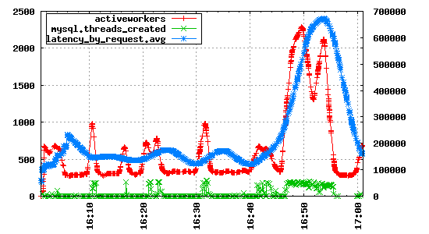
How to: Archive
stumbleupon.com
Using OpenTSDB to monitor all our machine and systems.
Storing 2.5B data points per week, more are added on a daily basis.
mozilla.com’s Socorro
Firefox crashes are stored in HBase for processing.

Slide 13
How to: Batch
Good old MapReduce
1 region = 1 map, can’t go lower without knowledge of the key space
Tools you can use: Hive, Pig, Cascading
Speculative execution should be disabled when reading/writing to HBase
Block caching is often useless when scanning, either disable completely or on the Scan

Slide 14
How to: Batch
stumbleupon.com
Hive is usually used by business analysts to combine MySQL, logs and HBase data and by developers seeking fast answers about their big data.
Cascading is used by engineers to write data pipelines for the ad system.
Pure MR are used by the research team for complicated machine learning jobs for our recommendation engine.
twitter.com
A copy of the tweets table is stored in HBase and processed, loaded via Elephant Bird.

Slide 15
How to: Batch & Real-time
Respecting SLAs versus trying to feed MR jobs with IO, best to avoid.
One option is to have 2 classes of clusters, one live and one MR.
Else, configure to have a few slots as possible. If scanning data that’s served live, better to avoid block caching.

Slide 16
Mandatory “We’re Hiring!” slide
Infrastructure Engineer
Database Administrator
Site Reliability Engineer
Senior Software Engineer (and more)
http://www.stumbleupon.com/jobs/
Help us building the best recommendation engine!

Slide 17
Questions?

